Slide 1
Video Summarization using Genetic Algorithm
Team Members –
Anubhav Rajput (20194037)
Anurudh Pratap Singh (20194067)
Divyanshi Agrawal (20194171)
Gaurav Dalal (20198069)
Group No.- CSA1
Under guidance of-
Dr. Ranvijay Singh

Slide 2
Outline
Introduction
Technology Used
Data Pre-processing
Algorithms used
Result Analysis
Future Work
References

Slide 3
Problem Statement
Video Summarization
The problem statement involves designing a video summarization model using Genetic Algorithm that automatically generates the summary of the videos.

Slide 4
WHAT IS VIDEO SUMMARIZATION?
Video summarization is the process of generating a shorter version or summary of a longer video, while preserving its most important or salient content.
The goal of video summarization is to provide a condensed representation of a video that captures the key events, objects, and actions, while removing redundant or irrelevant information.
Applied in variety of applications like CCTV surveillance, wildlife videography, documentaries, sports highlights and social media platforms.

Slide 5
Types of Video Summarization
Keyframe-based video summarization
Video skimming
Object-based video summarization
Motion-based video summarization
Semantic-based video summarization

Slide 6
Our implementation for keyframe-based video summarization using genetic algorithm

Slide 7
Technologies Used
Libraries Used
numpy
Yolo
Spacy
Open-CV
sklearn
Python
Jupyter Notebook
Vs Code
Dataset – TvSum50

Slide 8
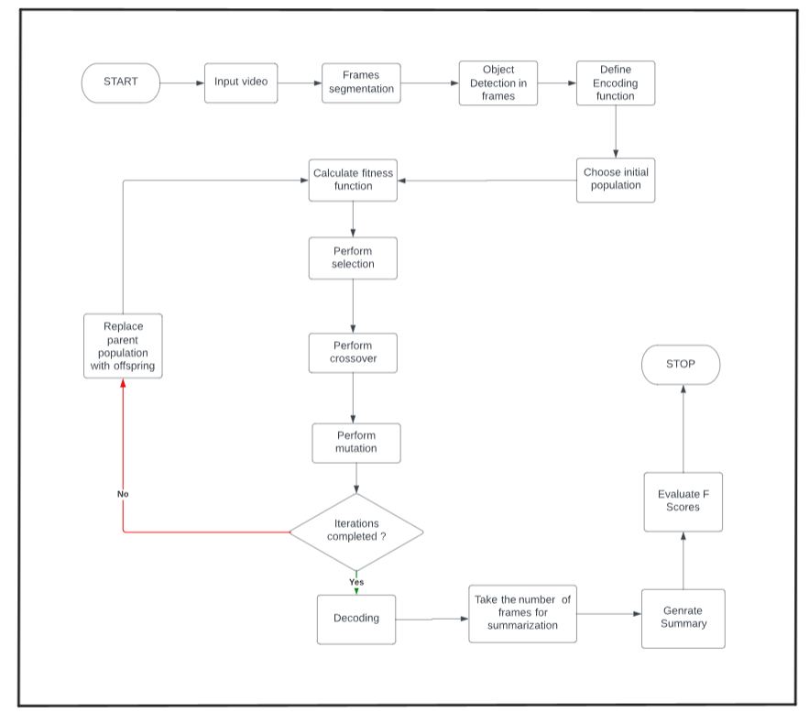
Work Flow

Slide 9
Data Pre-processing
Video Segmentation (converting video to frames)
Object detection (using YOLO)
Frame processing

Slide 10
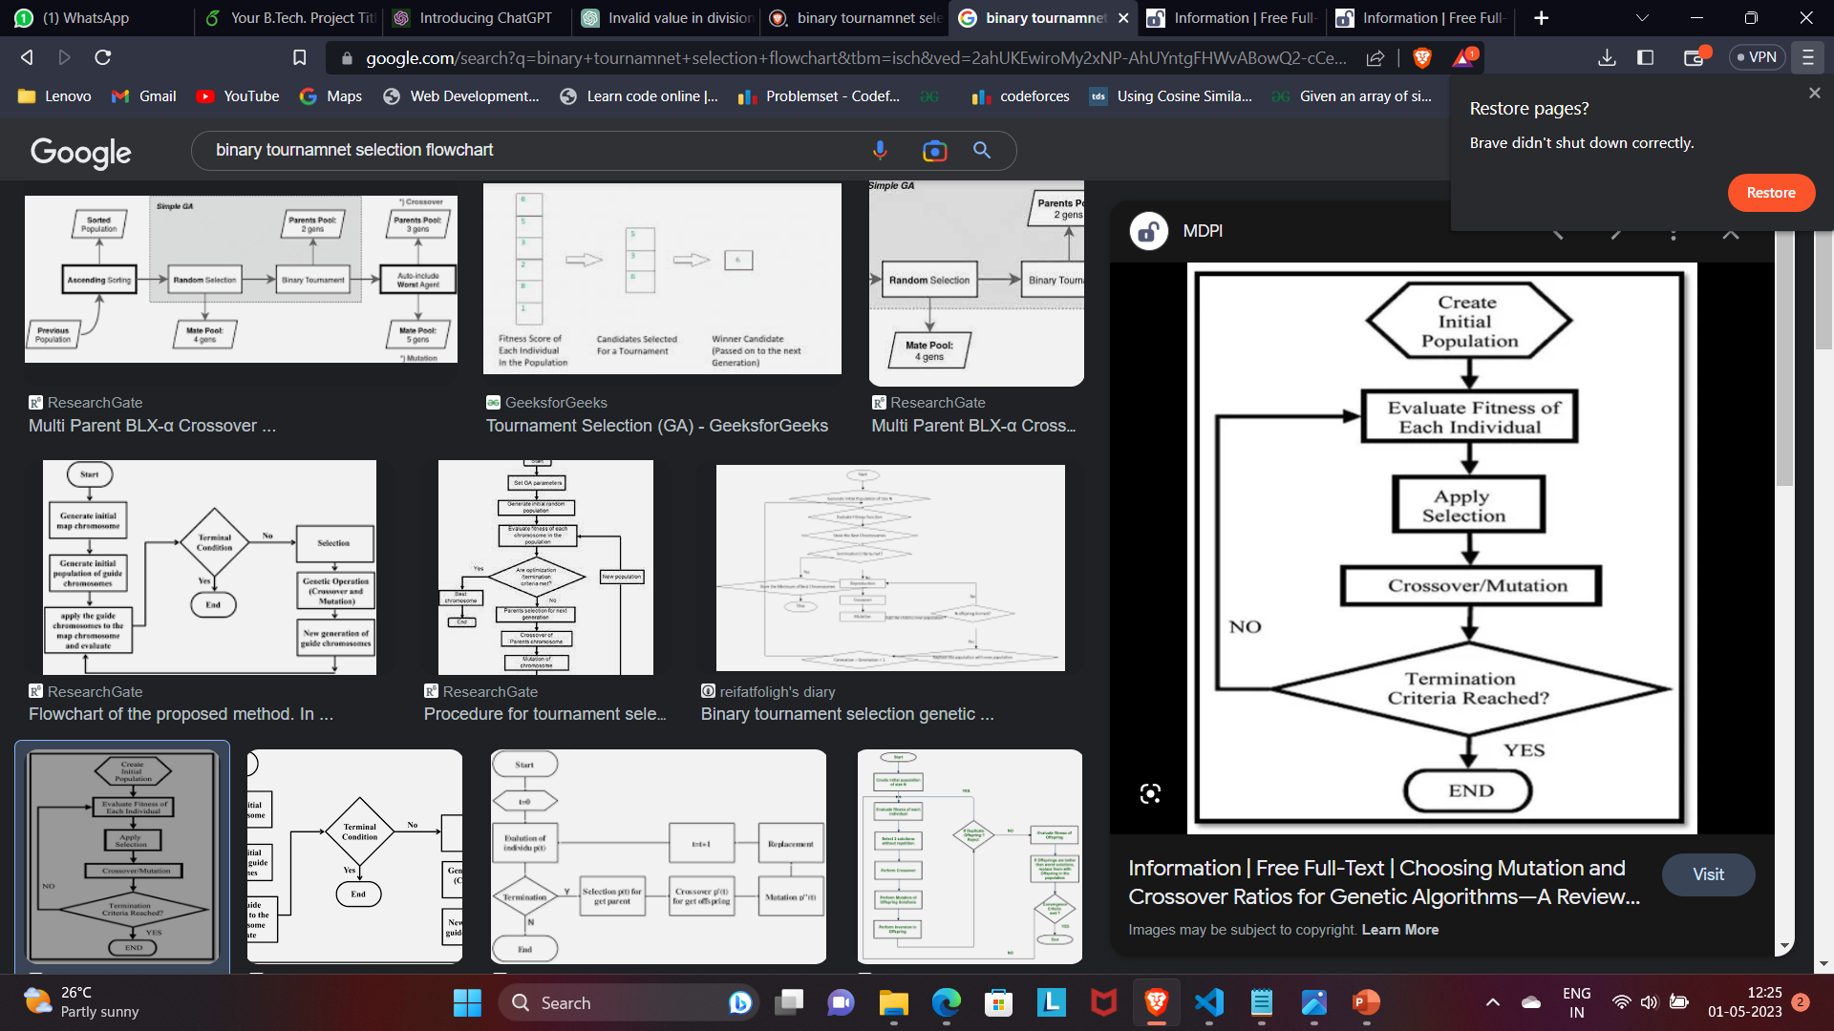
Genetic Algorithm
Genetic algorithms are a class of optimization algorithms that are inspired by the process of natural selection in biological systems.
In nature, the survival and reproduction of organisms is determined by their fitness, which is a measure of how well they are adapted to their environment.
The fittest individuals are more likely to survive and pass their genes on to the next generation, while the less fit individuals are less likely to survive and reproduce.

Slide 11
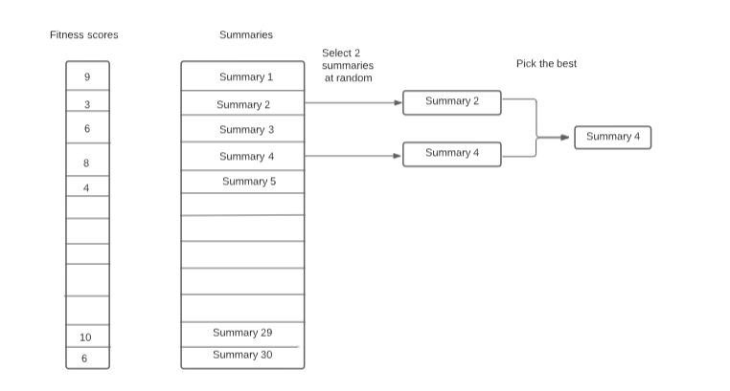
Selection
The selection step involves choosing the best chromosomes (summaries) from the population to form the next generation. This is done using binary tournament selection method .

Slide 12
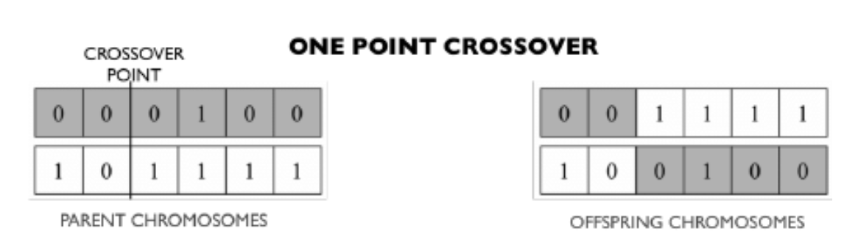
Crossover
Crossover is the process of combining two summaries to create new offspring summaries. For video summarization, crossover involves swapping segments between the two parents. Below are some types of selection methods.
Single point crossover is used in the proposed work,

Slide 13
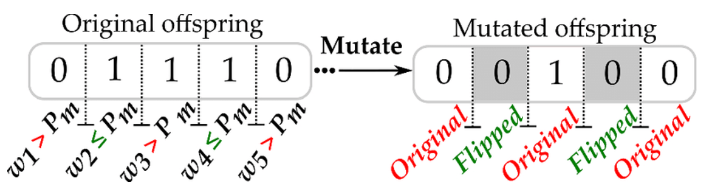
Mutation
Mutation is a random process that introduces small changes to the chromosomes to maintain genetic diversity in the population. For video summarization, mutation may involve adding or removing frames or segments from a summary.
Bit flip mutation is used in the proposed work.

Slide 14
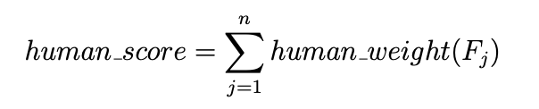
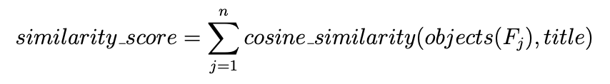
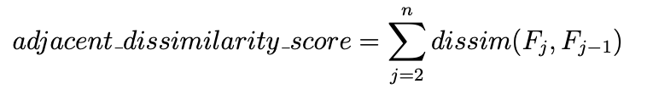
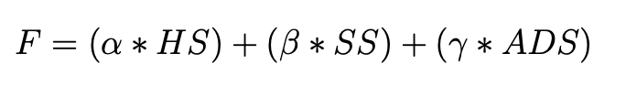
Fitness Function
A fitness function is a mathematical function used in genetic algorithms to evaluate the quality of potential summaries (chromosomes) to a given problem.
Fitness function used in our solution depends mainly on following parameters
human_score : depends on presence of human in the frame.
similarity_score: depends on the similarity of objects present in the frame with the provided title.
movement_score: depends on the difference between pixels of consecutive frames.
Finally the fitness of the solution is calculated as

Slide 15
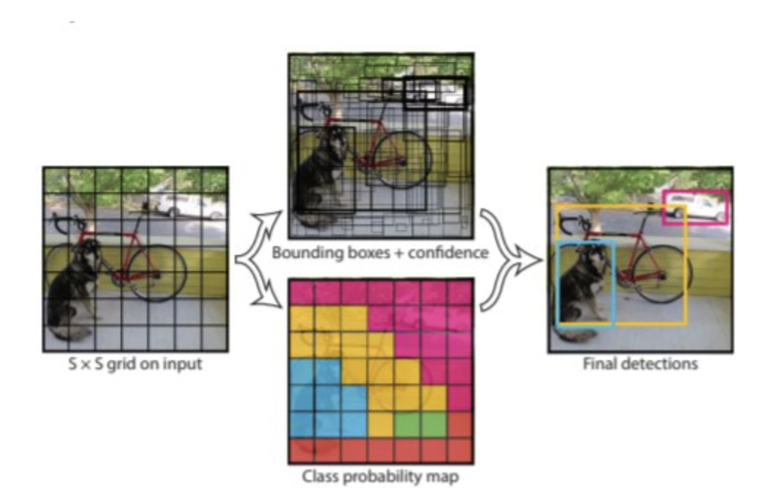
Yolo Model
You Only Look Once is a real-time object detection system that is able to detect and classify objects in an image with high accuracy and speed.
YOLO divides the input image into a grid of cells and predicts the object score, class probabilities, and bounding box coordinates for each cell. The object score represents the probability that an object is present in the cell, while the class probabilities indicate the likelihood of the object belonging to a particular class.

Slide 16
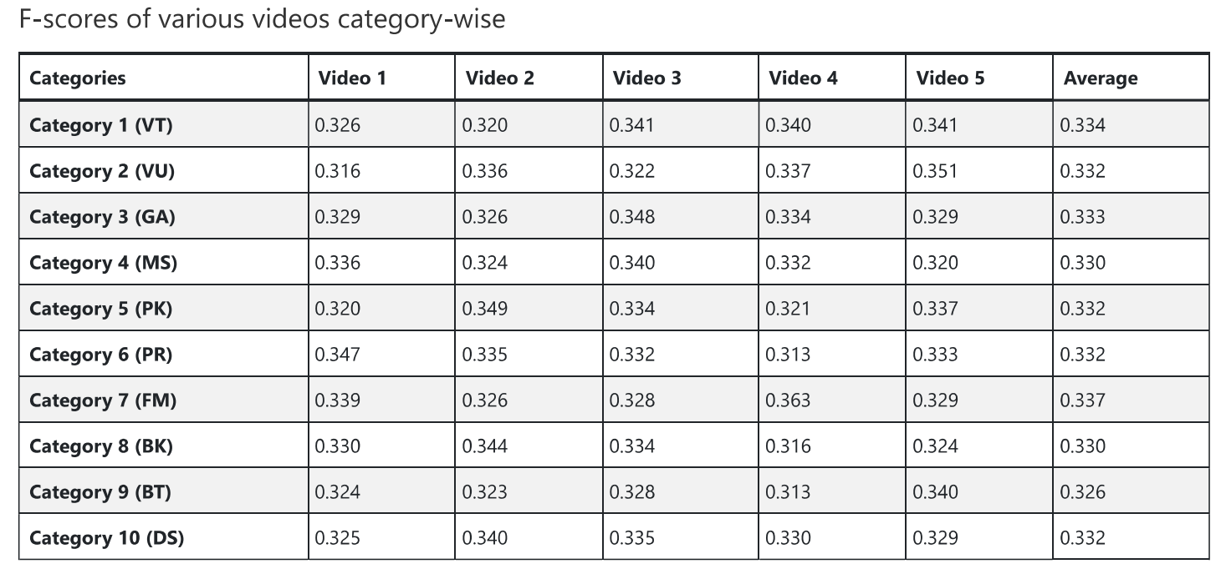
Result Analysis and Accuracy
The system generated summary is compared to human made summary F-Score is calculated for all 50 videos.

Slide 17
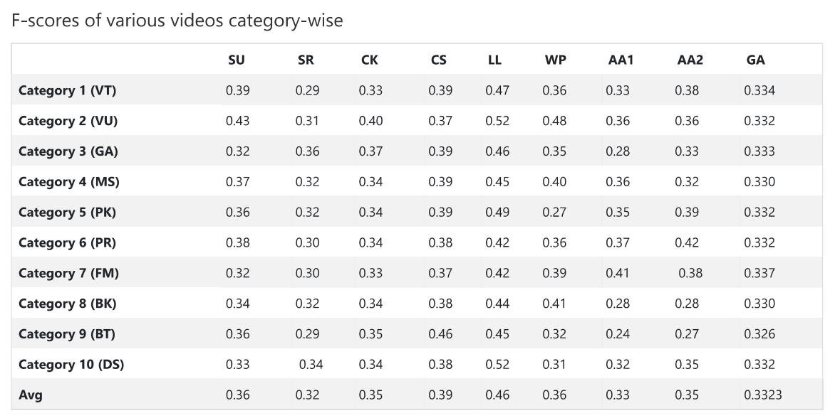
Result Analysis and Accuracy
Our genetic algorithm summary is also calculated with our models.
SU : Uniform Sampling
SR : Random Sampling
CK : k-means clustering
LL : LiveLight
WP : Web Image Prior(WP) AA1 : Archetypal Analysis from video data only
AA2 : Archetypal Analysis from video and image data

Slide 18
Future Work
In future we aim to optimize our fitness function. We can take single frame input from the user depicting object of interest and prioritize frames having higher similarity to that frame in our summary. Text content in frames can also be considered.
Genetic algorithm can be enhanced by incorporating domain-specific knowledge such as scene detection, object recognition, or audio analysis to improve the quality of the summary.
Additionally, we'll make sure the suggested model has adequate content coverage.

Slide 19
References
https://www.researchgate.net/publication/309770246_A_Study_on_Genetic_Algorithm_and_its_Applicationshttps://docs.python.org/3/library/tkinter.html#tkinter-life-preserver
https://www.cvfoundation.org/openaccess/content_cvpr_2015/papers/Song_TVSum_Summarizing_Web_2015_CVPR_paper.pdf
https://www.sciencedirect.com/science/article/pii/S1877050922001363
https://www.researchgate.net/publication/228731668_Automatic_Performance_Evaluation_for_Video_Summarization
https://opencv.org/

Slide 20
Thank You

